Slide 1

CS 562 presentation
Pengpeng(Team leader) JingTianZhang lu Cao ShuoZhang
2014/5/11

Slide 2
Lu Cao was working on the input attributes parameter parsing
Shuo Zhang was working on the input condition (such as) statement parsing
Jingtian Zhang was working on the big picture, flow work and general coding style
Peng Peng was working on detailed algorithm implementation and java code generation

Slide 3

Project Introduction
Problem
  MF queries expressed in standard SQL lead to complex relational algebraic expressions with multiple joins, group-by, and sub-queries.
  Traditional query optimizers tries to optimize a series of Join and group-by, leading to poor performance.
Solution
  Build a query processing engine for MF queries
  Extend group-by statement and add "Such that" clause to process succinct expression of MF queries.
Significance
  Our project simulates query processing engine and allows succinct
  expression of MF query and generates the Java source code which finally produces accurate and complete MF query.

Slide 4
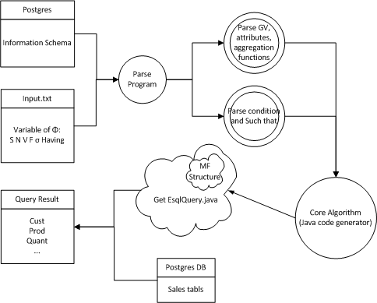
Overall Architecture(data-flow)

Slide 5
Input Analysis
During the first step of input analysis process, some questions need to be make clear, such as
  Witch attributes to show in the result?
  How many grouping variables the query has?
  Which attributes are used in grouping operation?
  To a centain group, what calculations need to be done?
  Which attributes are needed during the calculation but will not be shown in the result?
  In our program, several APIs are provided to read the first 4 paramaters respectively, exact key information from them, do comparison and make judgment, build mfstucture, and return the results anytime required for future opreation.

Slide 6
Input Analysis Cont.
Condition analysis is reading input text and parsing such that and having condition.
Slice every item of such that condition into different parts and store them. Eg grouping variable number, grouping attribute, operand, whether has aggregate function.
Conditions which have been stored can be retrieved according to specific grouping variable number.
Conditions parsed and stored is delivered to core algorithm for output java file.

Slide 7
Output template
This part program is to output the final java document.
We receive variables from MF-structure class. Based on the information we get from the previous steps, we determin which we need to output in our finalDB.java files.
For the output java program, we use Collection Class-Map and inner Class MF to store and process the data drawed from database. Based on the number of GV, we scanner n+1 times for get data we need.

Slide 8
Core Algorithm
Using Set<?> to eliminate duplicates
Using Map<String, MFStructure> to store all key value (ex: cust - prod)map to each MFStructure instance
Making MFStructure variables value updating during n+1 scans
Calculate avg_variable after each scan if needed
Distinguish number and String comparison
Dynamic generate “if else” statement
Generated outPrintTable() function dynamically generates beautiful table format of output result
Generated java code has perfect format

Slide 9
Query Structure
SELECT ATTRIBUTES(S):
cust,prod,1.quant,2.quant,1_sum_quant,2_avg_quant,2_sum_quant
NUMBER OF GROUPING VARIABLES(n):
2
GROUPING ATTRIBUTES(V):
cust, prod
F-VECT([F]):
1_sum_quant,2_avg_quant,2_sum_quant
SELECT CONDITION-VECT([σ]):
1.year=1990
2.year=1991

Slide 10
Test
We have used 6 input.txt file to test the correctness of the generated java code
We test the correctness by comparing the query result generated by the java code and the query result generated by standard Sql statement

Slide 11
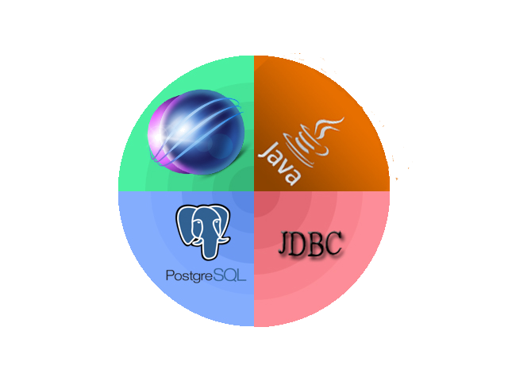
Technology
Technology: Java, Eclipse, PostgresSQL, JDBC

Slide 12
Summary
Strength
  Multiple attributes of table with aggregate function can be updated and output to generated file
  Variety of schemas can be applied to our designed query processing engine
  The output result is dynamically generated
  The generated java code has tree format
Future work
  Provide support for minimal scanning
  Provide having clause processing
  Provide support for EMF query
Company Logo

Slide 13

Thanks for Listening

